Slide 1



SPENDGUARD
Presented by Team Data Dash

Slide 2
Introduction
Team Data Dash
Mohammed Amaan
Jobinjoy Ponppal
Aleena Thomas
College: Saintgits College of Engineering, Kottayam, Kerala

Slide 3
Problem Statement
Parents face difficulty in ensuring that money provided to children under 18 for school expenses is used appropriately or are used for any other reasons such as drugs, alcohol, etc. , as they lack visibility into expenditure and the children lack access to UPI-based apps for transaction as the parents will not be able to track the expenditures.

Slide 4
Solution
Our Solution to the problem statement is SPENDGUARD.
It is an application based on School accounts and each school has a
unique school code. Every student’s parents have their account
linked with the school account and every student has a unique
bar code that is on their identity cards(ID). Each student has
needs from the school premises such as Canteen, Xerox, Stationery,
etc. , that is made through this barcode and each expenses that are done by the student is visible to the parent through the app.

Slide 5
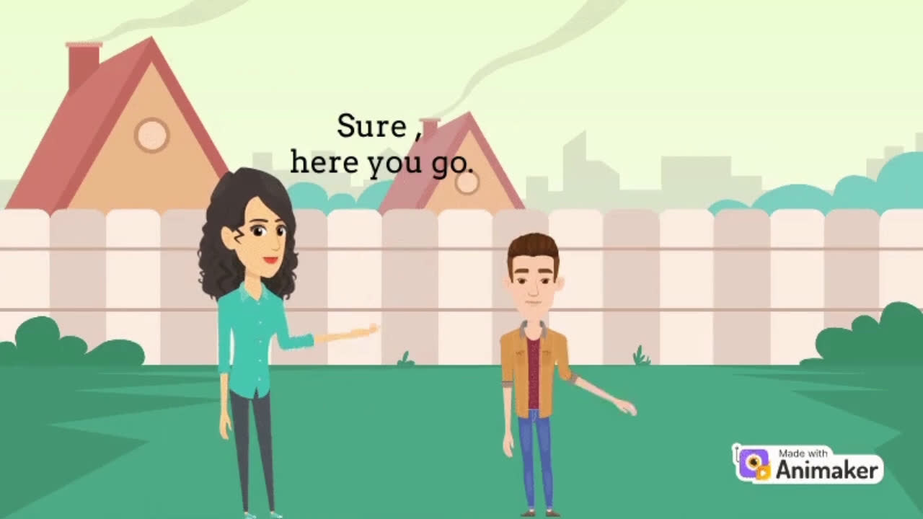

Slide 6
Features
01
02
Allows to set limits for each categories that are necessary for day to day school life.
Monitors transaction histories effectively.
03
04
User friendly User Interface that helps to understand the working of the app.
Gives the expenditure list monthly and weekly.

Slide 7
Working
Front-end:
HTML, CSS, JavaScript, Figma
Back-end:
MySQL DB, php
Server Host: XAMPP
Payment Gateway: Stripe
Database Link: http://localhost/phpmyadmin/index.php?route=/database/sql&db=university_db
http://localhost/spendguar[1].php

Slide 8
Conclusion
As drug and substance abuse among teenagers rises, it's imperative to intervene early. SPENDGUARD empowers parents to monitor school expenses, hold back potential misuse and steering youth away from addictions. By fostering parental oversight, SPENDGUARD plays a vital role in safeguarding the future of youngsters, mitigating the risk of addiction, and promoting healthier lifestyles.

Slide 9
Thank
You

